Slide 1
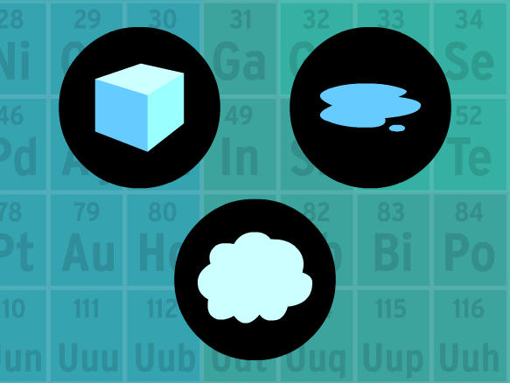
Matter
Matter: anything that has mass and takes up space. (made of atoms)
The 3 main states of matter are solids, liquids, and gasses

Slide 2
What is The Kinetic Theory of Matter?
Kinetic theory of matter: explains that states that ALL particles of matter are in CONSTANT motion.
  Solids: particles are vibrating slowly in place
  Liquids: particles move more freely than in a solid, sliding over one another
  Gas: particles move at high speeds and spread apart
Which state of matter has the most energy?

Slide 3
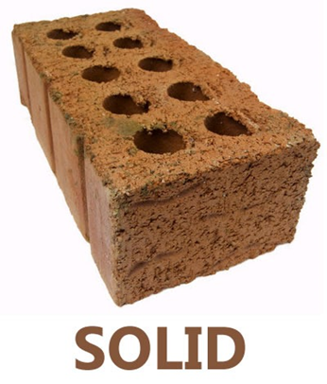
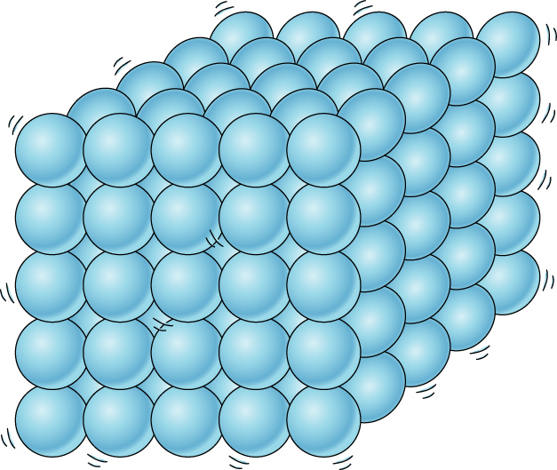
Solids
- Solids have a definite volume and shape (does NOT change)
-Particles are tightly packed together
-Particles vibrate in place, low energy level

Slide 4
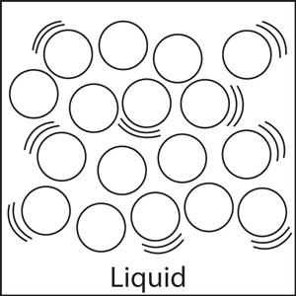
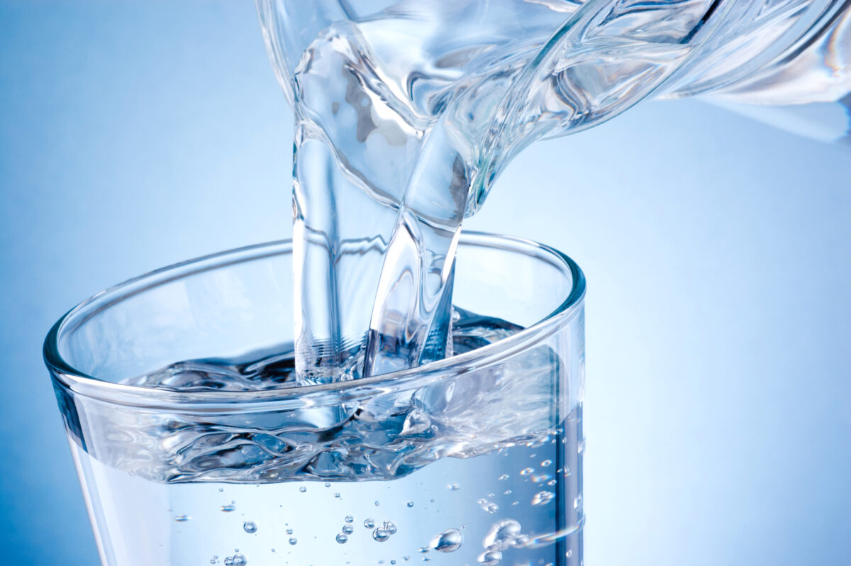
Liquids
- Liquids do NOT have a definite shape but have a definite volume (changes based on their container)
-Particles are loosely held together and have some space in between
- Particles slide past one another, medium energy level

Slide 5
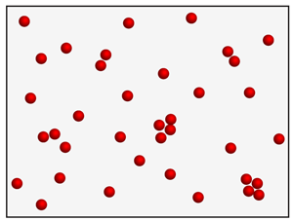
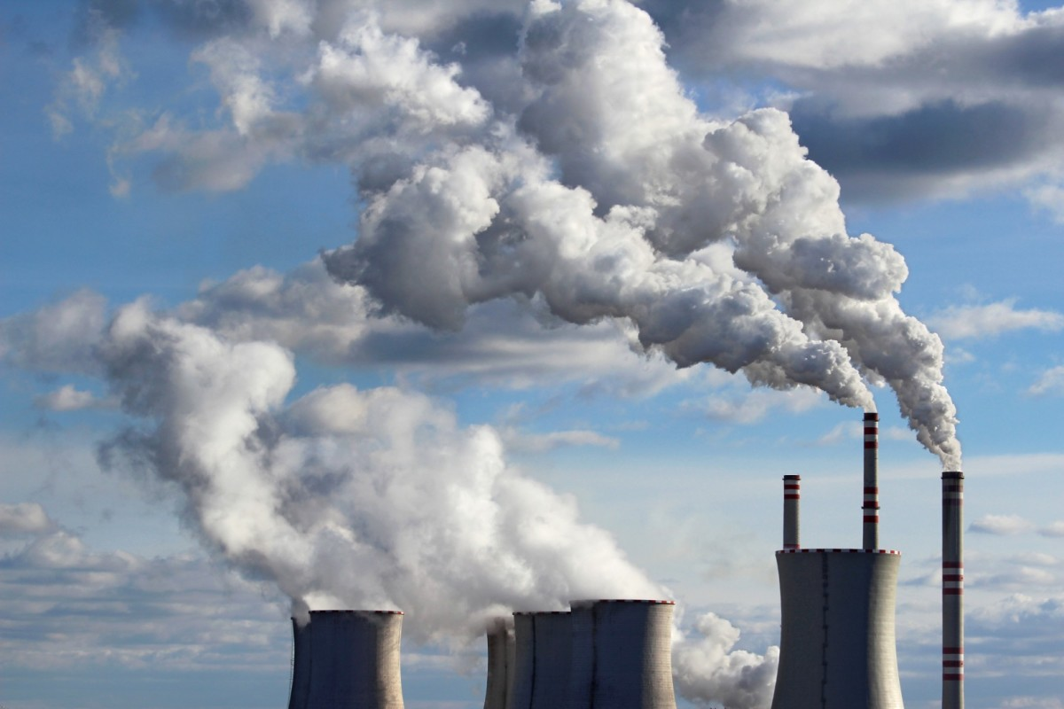
Gasses
- Gasses do NOT have a definite shape or volume (changes based on their container)
-Particles are greatly spaced out
-Particles move fast and freely, high energy level

Slide 6
